Slide 1

Epic Consulting Services
Learn More

Slide 2
Leverage Healthcare Triangle’s Epic consulting services designed to ensure healthcare organizations and clinics get the greatest value, performance, insights, and ROI from their Epic platforms.
Click Here

Slide 3
Enrich Your Epic Experience with HCTI​
With robust Epic EHR technology solutions as your foundation and Healthcare Triangle as your trusted partner, we propel your healthcare organization's initiatives forward to achieve your objective of the best possible patient care. Our hands-on consulting services provide compelling implementation and support of Epic EHR — delivering more robust performance, creating greater efficiency, and enhancing patient safety and health outcomes.

Slide 4
Our Areas of Epic Expertise
· Epic Consulting
· Epic Implementation
· Epic Migration
· Epic Optimization
· Epic BackUp & DR Hosting
· Epic Integration
· Community Connect
Connect our Experts

Slide 5

Epic Consulting
Healthcare Triangle’s Epic consulting services meet the growing demands/needs of hospitals, ambulatory clinics, and other healthcare organizations transitioning to or implementing Epic.
Click Here

Slide 6

Epic Implementation
To ensure a smooth Epic implementation, HCTI Epic experts work with your team to pinpoint, review, and manage potential problems within your IT program to mitigate operational risks and maximize EHR investments and experience.
Click Here

Slide 7

Epic Migration
HCTI's Epic consulting is comprised of the most experienced and qualified Epic consultants in the industry who comprehend the value and challenges of integrated Epic EHR migration.
Click Here

Slide 8

Epic Optimization
At Healthcare Triangle, we have the proficiency and knowledge to help healthcare organizations become more efficient using Epic software.
Click Here

Slide 9

Epic BackUp & DR Hosting
We use state-of-the-art encryption to make sure your data is secured and private. Epic Cloud Backup and Disaster Recovery from HCTI is provided on all major cloud platforms.
Click Here

Slide 10

Epic Integration
HCTI's readabl.ai, the medical document automation solution, uses FHIR APIs or HL7 to integrate with a customer's EHR to provide further confidence when matching patients, integrating to workflows, etc.
Click Here

Slide 11

Community Connect
HCTI's Community Connect and Acquisitions services enhance interoperability with a nearby health system to help realize a lower cost EHR implementation.
Click Here

Slide 12
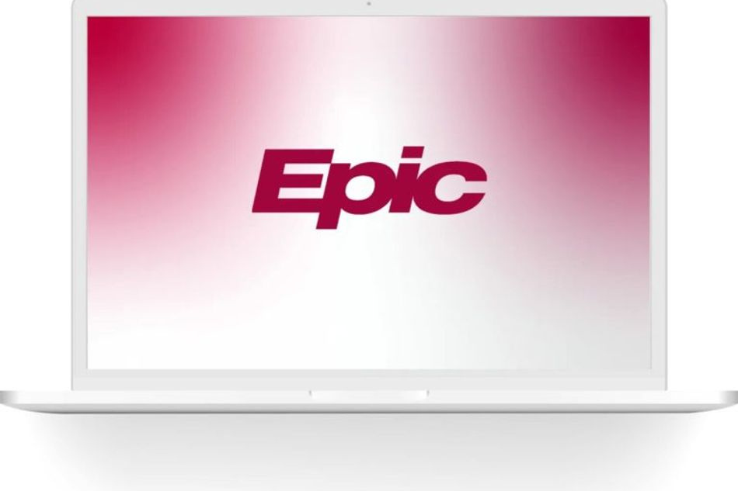
Visit : www.healthcaretriangle.com
Mail : info@healthcaretriangle.com

